Slide 1
Eagle Project LED Schematic Symbol Mismatch Issue
2023/05/24

Slide 2
1
Problem Description
AGENDA
2
Root Cause Analysis
2
Corrective Action

Slide 3
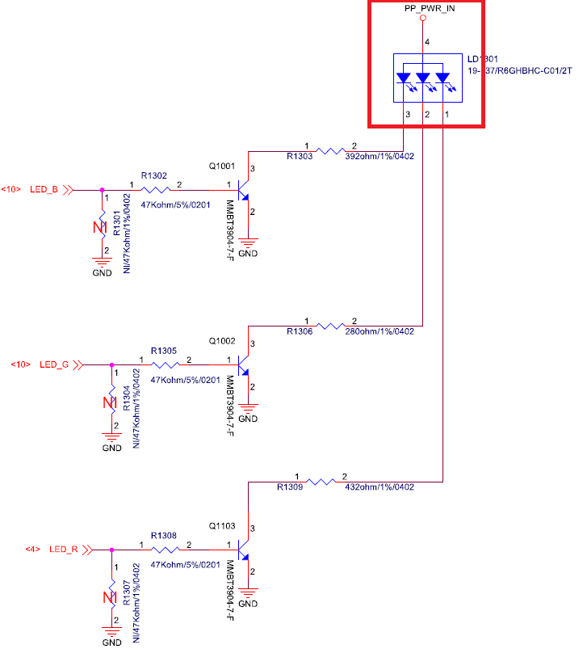
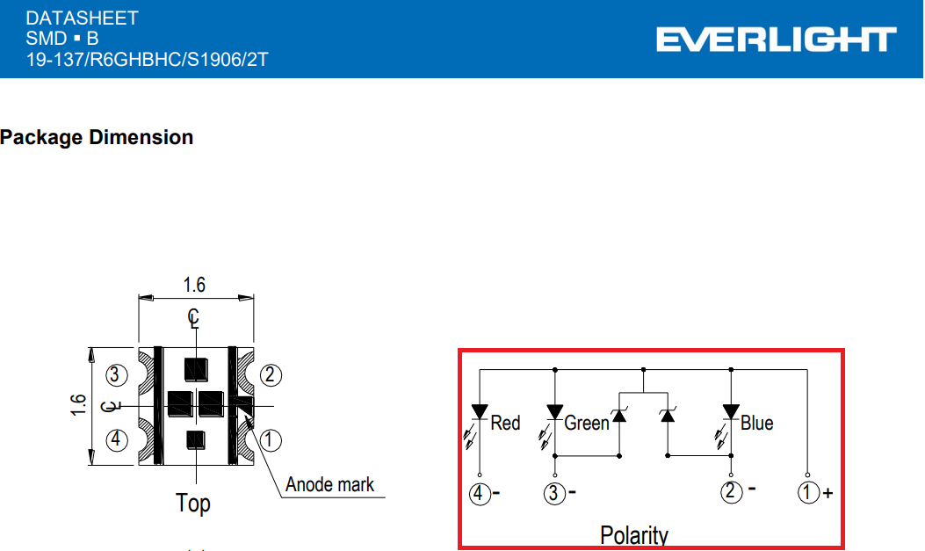
Problem Description
LED schematic symbol pin number is mismatch with datasheet
The following table indicates the difference between schematic symbol and datasheet :
It will cause the misunderstood of LED circuit compared with datasheet.
 | Fii symbol | LED datasheet
VCC | Pin 4 | Pin 1
R | Pin 1 | Pin 4
G | Pin 2 | Pin 3
B | Pin 3 | Pin 2
Photo1: Original schematic
Photo2: LED datasheet

Slide 4
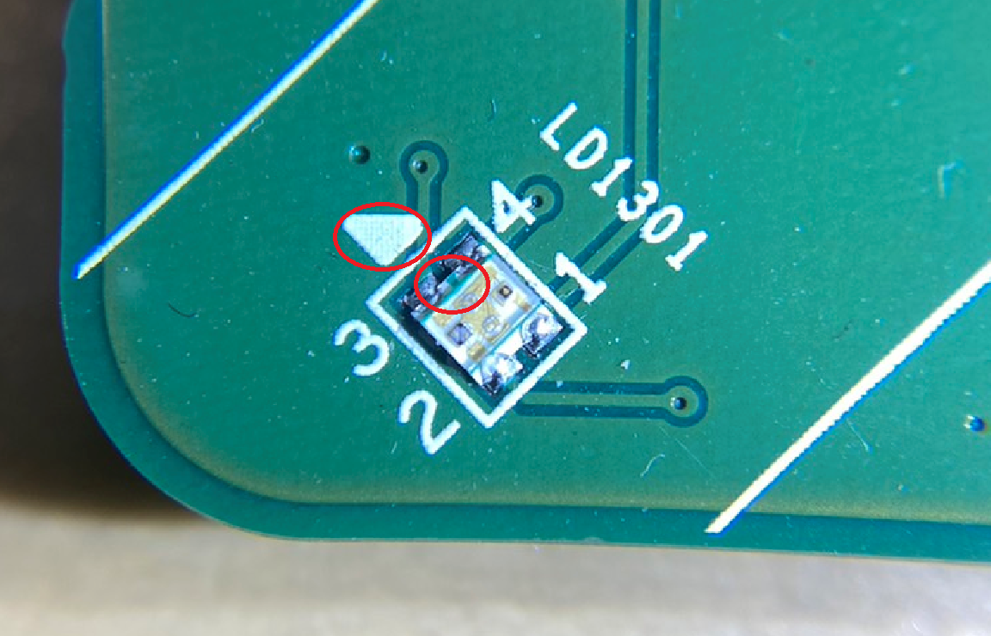
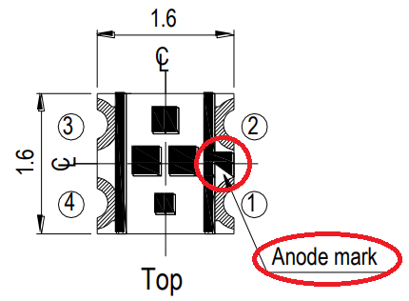
Root Cause Analysis
Fii used the existing LED schematic symbol and layout footprint in design pool instead of apply a dedicate one due to tight schedule in the beginning of design phase.
However, the circuit design is followed by the LED chip we use, and the silk printing of polarity on the PCB is matched with LED chip, which is guarantee the design functionality and production.
Polarity index on PCB silk printing
polarity index of LED chip
Photo3: Datasheet Anode mark
Photo4: Eagle LED Anode mark

Slide 5
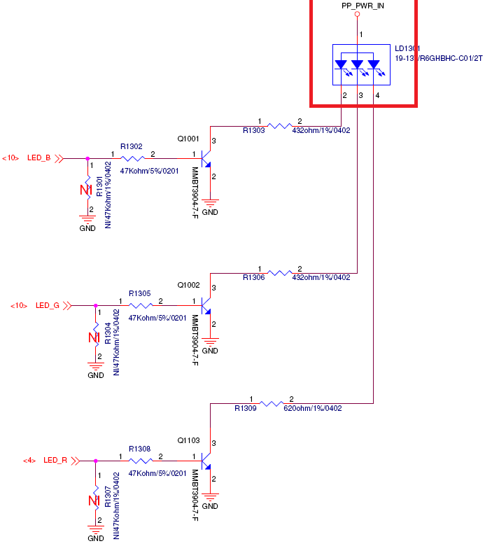
Corrective Action
Corrected the symbol of LED chip to the schematic.
Fii RD will review the parts have polarity requirement and compared its corresponding symbol/footprint by checklist to make it won’t have mismatch issue in future projects.
Photo5: Correct schematic

